Slide 1
Retirement Income:
IRAs and Pensions
Pub 4491 – Part 3
Pub 4012 – Page D-18
Notes:
1
Significant Changes for Release 2:
Slides #21 - #26 Added slides for Rollovers
It is best if you can have counselors review IRA and Pension Income in Pubs 17, 4491 and 4012 prior to coming to class. Give the following guidelines or develop your own. Self-study should be guided (as opposed to Read The Chapter).
4491 – Page iii –
Are any of the changes for 2016 directly relate to Retirement Income?
Pub 4491 –
Are there any changes in the current publication compared to the 2015 TY publication?
Pub 4491 – Review the 7 TIPs and summarize them.
Pub 4012 – Where can one find the Codes for 1099-R Box 7?
Where can one find the Exception Codes and explanations for Premature Distributions from IRA or Retirement Plans?
What form will show Instructions for additional exceptions?

Slide 2

Types of Retirement Income
Individual Retirement
Arrangement (IRA) Distributions
Pensions
Annuities
Social Security (covered in a separate lesson)
Notes:
Several types of IRAs – will discuss in detail [Note – these are not Individual Retirement Accounts!]
Pension: Series of determinable payments made to employee (or survivor) after retirement from work
Annuity: Payments under contract from insurance company, trust company or individual

Slide 3
Retirement Income Reported on:
Form 1099-R – Distributions From Pensions, Annuities, Retirement or Profit-Sharing Plans, IRAs, Insurance Contracts, etc.
Form RRB 1099-R – Annuities or Pensions by the Railroad Retirement Board
Form CSA 1099-R – Statement of Annuity Paid (civil service retirement payments)
Form CSF 1099-R – Statement of Survivor Annuity Paid

Slide 4
Four Types of IRAs
Pub 17 Chapter 17
Traditional
Roth
Savings Incentive Match Plans for Employees (SIMPLE)
Simplified Employee Pension (SEP)
Notes:
Traditional IRA
typically, fully deducted when contribution was made
If not, need form 8606 Part I – look at prior year
Roth
Not deductible when contribution is made
Not taxable when distributed – IF rules are followed
SIMPLE/SEP A variation of a traditional IRA that may be partly or wholly funded by an employer
Typically, fully taxable when distributed

Slide 5
IRA Distributions
Pub 17 Ch 17
Regular
Required minimum distribution (RMD)
Trustee to trustee transfer
(not taxable)
Rollover
(not taxable if done correctly)
Notes:
Trustee-to-trustee: 100% not taxable (also referred to as “transfer”)
Trustee will normally not issue a 1099-R
If 1099-R is issued, should be code G (not taxable)
Can be done as often as taxpayer wishes
Taxpayer takes funds
Not taxable if rolled to another traditional IRA within 60 calendar days
Part not rolled is taxable
Possible additional tax if < 59½
Allowed one rollover in any 12-month period from the from any IRA to any IRA
From a company plan to an IRA or vice-versa, no limit

Slide 6

Intake and Interview
Notes:
Checks in either yes or unsure for either item 10 and 11 are the key to ask additional questions as delineated on the next slide

Slide 7
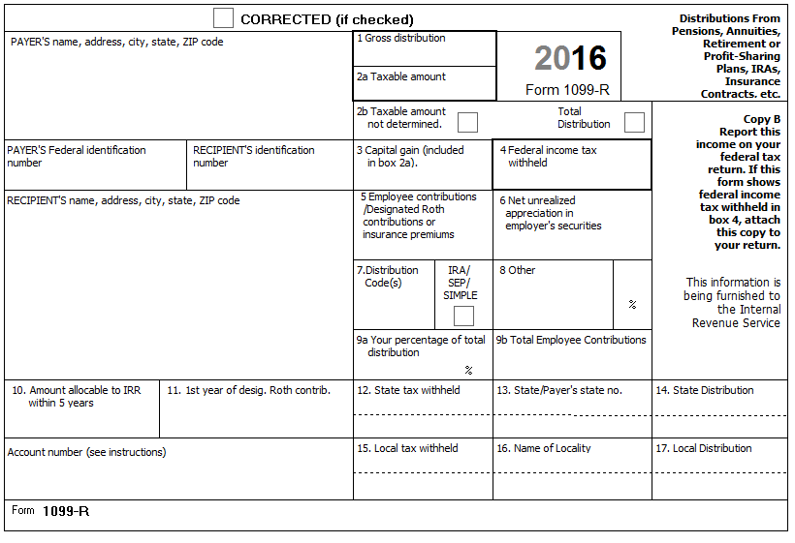
1099-R
What is this form telling you?
Notes:
Box 1 – Gross distribution
Box 2a – Taxable amount – NOTE: If taxable amount is determined no further action is needed to determine taxable amount
If Taxable amount not determined is checked, Simplified General Rule calculation will be required.
Box 9b indicates employee contribution which will be used in the Simplified General Rule if taxable amount is not included in box 2a.
If box 2a is zero (not just blank), the distribution is non taxable . Correct Box 2a to read zero.)
Box 7 – Distribution code covered in one of next charts
Box 7 – Checked if IRA
Boxes 4 and 12 – Federal and State Income tax withheld
BOX 7 IS FIRST PLACE TO LOOK!

Slide 8
Form 1099-R
Must have correct SSN on form
If not correct – taxpayer needs to get corrected Form 1099-R
If ITIN return, e-file return in normal manner – if ITIN was not renewed, taxpayer will receive notice from IRS
If ITIN return and cannot get a 1099-R with the ITIN, need to paper file the return (cannot be e-filed)

Slide 9
Interview – Traditional IRA
With 1099-R in hand – if IRA box checked:
  What type of IRA? – Traditional
  Did taxpayer ever make non-deductible contributions?
  If early distribution, is there an exception to avoid additional tax?
  If rollover was made, was it timely?
  (60 days or less – covered in later slides)
  Was a qualified charitable distribution made? (QCD – covered in later slides)

Slide 10
Interview – Roth IRA
With 1099-R in hand – if IRA box checked:
  What type of IRA? – Roth
  Was any part a conversion? When?
  If early distribution, is there an exception to avoid additional tax?
  If rollover was made, was it timely?

Slide 11
Interview – SEP/SIMPLE
With 1099-R in hand – if IRA box checked:
  What type of IRA? – SEP/SIMPLE
  Confirm all is taxable
  If early distribution, is there an exception to avoid additional tax? (see Pub 4012, H-2)
  If rollover was made, was it timely?

Slide 12
IRA Box 7 In-Scope Distribution Codes
7 | Normal distribution (most common)
1 | Early withdrawal, no known exception, 10% additional tax
2 | Early distribution, exception applies
3 | Disability
4 | Death
6 | Tax-free Section 1035 exchange*
*In scope for Tax-Aide only – distribution is nontaxable
Notes:
Generally, codes are listed on the back of Form 1099-R.
All codes and in or out of scope status at Pub 4012 page D-20
Code G Rollover –
Max 1 per 12 months from same IRA or IRA to which a rollover was made within 12 months
Check boxes on 1040 lines 15b and 16b as applicable

Slide 13
IRA Box 7 In-Scope Distribution Codes
B | Designated Roth account distribution
F | Charitable gift annuity
G | Rollover not taxable, no additional tax applies
H | Rollover from designated Roth to Roth IRA
Notes:
Use F1 to see all codes. Generally, codes are listed on the back of Form 1099-R.
Code G Rollover –
Max 1 per 12 months from same IRA or IRA to which a rollover was made within 12 months
Check boxes on 1040 lines 15b and 16b as applicable
A designated Roth is one that is part of an employer plan and may be rolled into a Roth IRA

Slide 14
IRA Box 7 In-Scope Distribution Codes
Q | Qualified distribution from a Roth IRA
S | Early distribution from a SIMPLE IRA in the first 2 years, no known exception
U | Dividends distributed from an ESOP under section 404 (k)
W | Charges or payments for purchasing qualified long-term care insurance contracts under combined arrangements*
* In scope for Tax-Aide only – Distribution is nontaxable and payment for LTC is not deductible
Notes:
Use F1 to see all codes. Generally, codes are listed on the back of Form 1099-R.
Code G Rollover –
Max 1 per 12 months from same IRA or IRA to which a rollover was made within 12 months
Check boxes on 1040 lines 15b and 16b as applicable
A designated Roth is one that is part of an employer plan and may be rolled into a Roth IRA

Slide 15
IRA Box 7 In-Scope Distribution Codes
Possible double letter codes
  Look up each letter
  Example
    G4 – rollover distribution to beneficiary upon death of account holder

Slide 16
IRA Box 7 Out of Scope Distribution Codes
If Form 8606 pops up for a 1099-R Box 7 Code J or T, tax return is Out of Scope.

Slide 17
Traditional IRA Distributions
Pub 17 Ch 17
Required Minimum Distribution (RMD)
  Must take required minimum distribution – age 70½
  Must take by April 1 of year following
  Can avoid two distributions taxed in one year by taking first in year turn 70½
Notes:
RMD each year is based on the individual’s life expectancy as set out by the IRS
Will never be 100% of the IRA

Slide 18
Traditional IRA RMD
IRA administrator (trustee) normally calculates RMD
Taxpayer is responsible to take RMD
50% additional tax for amount not distributed (“too late” penalty)
Can request waiver of additional tax using Form 5329 Part IX

Slide 19
Traditional IRA RMD
Can take total RMD from one account rather than from several accounts (but cannot aggregate individually owned account(s) with account(s) received as a non-spouse beneficiary)
If taxpayer is 70½ or older, confirm with taxpayer that total RMD was taken (probing question)
Notes:
If taxpayer has several IRA accounts and must take RMD, s/he can take total RMD for all accounts from one account. Does not need to take an RMD from every account. BUT, cannot aggregate RMDs from individually owned account(s) with RMDs from accounts received as a non-spouse beneficiary

Slide 20
RMD Failure – Waiver Request
Request waiver of additional tax using Form 5329 Part VIII
  Explain situation (relied on trustee, clerical error in calculation)
  Taxpayer needs to correct by taking the missed distribution amount (results in bunching of more than one distribution in the year corrected)

Slide 21
Rollovers
Move retirement savings from 401(k), profit-sharing plan, etc. into IRA
Move IRA from one trustee to another
Cannot rollover RMD
Notes:
IRAs: You can roll over all or part of any distribution from your IRA except:
A required minimum distribution or
A distribution of excess contributions and related earnings.
Retirement plans: You can roll over all or part of any distribution of your retirement plan account except:
Required minimum distributions,
Loans treated as a distribution,
Hardship distributions,
Distributions of excess contributions and related earnings,
A distribution that is one of a series of substantially equal payments,
Withdrawals electing out of automatic contribution arrangements,
Distributions to pay for accident, health or life insurance,
Dividends on employer securities, or
S corporation allocations treated as deemed distributions.

Slide 22
Rollovers
Direct (trustee to trustee)
  Unlimited number per year
  Non taxable
  Generally code G

Slide 23
Rollovers
60-day rollover: trustee to taxpayer to trustee
  Portion taxpayer deposits in IRA within 60 days is non-taxable
  Only one rollover from any IRA to another in any 12-month period regardless of number of IRAs owned

Slide 24
60-Day Limit Exception
If taxpayer misses 60-day window, can self-certify that met requirements for waiver if
  Presents letter to financial institution receiving the late rollover contribution
  Rollover satisfies all other requirements (except 60-day requirement)
  Can show that one or more of the reasons listed in the Model Letter prevented taxpayer from completing rollover on time
  IRS has not previously denied request for a waiver
  Rollover is made as soon as practicable (usually within 30 days) after reason or reasons for delay no longer prevent taxpayer from making contribution
Notes:
IRS may audit your income tax return to verify that taxpayer qualified for a waiver.
Rollover - Indirect transfer**
Written self-certification-Certification Model Letter in the Appendix of Rev. Proc. 2016-47 Waiver of 60-Day Rollover Requirement Section 3.
Eleven Conditions for self-certification
Error committed by the financial institution…
Distribution, in form of check, was misplaced or never cashed
Distribution deposited into and remained in account mistakenly thought to be an eligible retirement plan
TP’s principal resident was severely damaged
Member of TP’s family died
TP or a member of the TP’s family was seriously ill
TP was incarcerated
Restrictions were imposed by a foreign country
Postal error occurred
Distribution made on account of a levy under §§6331 and proceeds of levy have been returned to the TP
Party making distribution to which rollover relates delayed providing information that the receiving plan or IRA required to complete the rollover despite the TP’s reasonable efforts to obtain the information

Slide 25
60-Day Limit Exception
Financial institution not required to accept self-certification
IRS requires IRA trustee to complete Form 5498 to accept delayed rollover contribution

Slide 26
Incomplete Rollover
If taxpayer receives Form 1099-R for distribution that he or she has or will rollover
  Enter $0 for taxable amount in box 2a
    Indicate it is a rollover
    Tell the taxpayer
      S/he needs to pursue the waiver
      They may have issues down the road with the IRS
Notes:
Enter the 1099-R and zero out the taxable amount and indicate it was a rollover and tell the taxpayer they need to pursue the waiver and that they may have issues down the road with the IRS.
It’s the taxpayer’s return and much like we accept that they will contribute to their IRA before April 15, we accept that they will complete the rollover

Slide 27
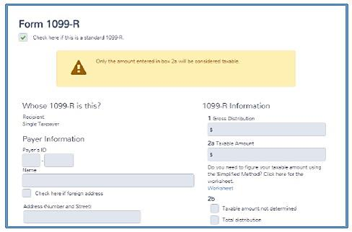
1099-R – Box 7 Code Q
Box 7 - Code Q = Not taxable
Enter Gross Distribution
Enter zero taxable amount
$ 0
Notes:
Form 8606 is NOT needed with 1099-R Box 7 Code Q.
There is no taxable amount!

Slide 28
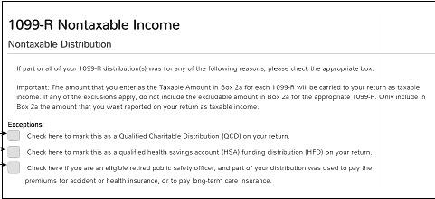
1099-R Nondeductible IRA
This can exclude QCD, HSA, or PSO. See Pub 4012 D-25.

Slide 29

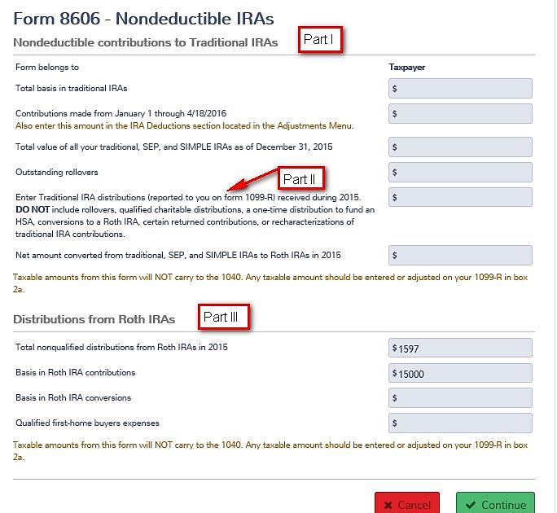
Form 8606 –

Slide 30
Form 8606 – Part I
Nondeductible Contributions to Traditional IRAs and Distributions From Traditional, SEP, and Simple IRAs
Running record of nondeductible contributions and remaining basis
  The basis in IRA is recovered each year based on a ratio
    That year’s distribution
    Compared to value of all Traditional IRAs
Notes:
Applies to Traditional IRA (not Roth IRAs)
If more than one Traditional IRA account, must add them up for the taxpayer or the Spouse separately

Slide 31
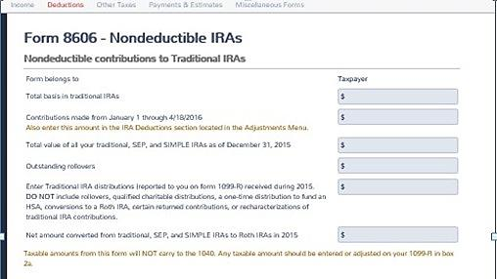

8606 – Part I (In Scope)
Nondeductible IRA Contributions
Part I
8606 – Part II – Conversions - Out of Scope
Notes:
TP made nondeductible contributions to a traditional IRA for 2016 Y.
TP took distributions from a traditional, SEP, or SIMPE IRA in 2016 and TP made nondeductible contributions to a traditional IRA in 2016 or an earlier year.
[A distribution does not include a rollover, one-time distribution to fund an HSA, conversion, recharacterization, or return of certain contributions..]
TP converted part, but not all, of his/her traditional, SEP, SIMPLE IRAs to Roth IRAs in 2016 (excluding any portion TP recharacterized) and TP made nondeductible contributions to a traditional IRA in 2016 or an earlier year.

Slide 32
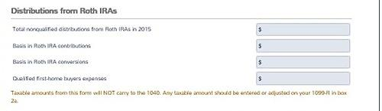
8606 – Part III
Distributions from Roth IRAs (out of scope)
Part III

Slide 33
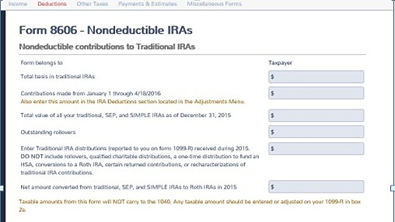
Form 8606 – Part I
Taxpayer must provide value of all Traditional IRA accounts as of end of current tax year
TaxSlayer takes taxable portion of IRA distribution to 1040 Line 15b
Total Basis
Contributions
Outstanding Rollovers
Distributions from
Traditional SEP and
Simple IRAs
Notes:
If there are outstanding rollovers or other complicating factors, either complete the form or refer the taxpayer to a paid preparer

Slide 34
Roth IRA
Contributions are not deductible
Distributions tax free if conditions met
  Pub 17, last page of chapter 17
  Otherwise out-of-scope
Notes:
34

Slide 35
Qualified Roth IRA Distributions
No additional tax if:
  Made after the five-year period beginning with first contribution -AND-
  Made on or after age 59½ -OR-
  Disabled -OR-
  Death -OR-
  To pay up to $10,000 of certain qualified first-time homebuyer amounts

Slide 36
SIMPLE or SEP IRA Distributions
Taxed like Traditional IRA – fully taxable
Early distribution within 2 years – additional tax applies (SIMPLE at rate of 25% if box 7 code is “S”)
RMD rules apply
Notes:
Simple IRA – Savings Incentive Match Plans for employees may include both employee pre-tax and employer contributions. Generally fully taxable when employee receives IRA distribution
Simplified Employee Pension (SEP) IRA – Employees can contribute part of their pre-tax pay to an IRA. Generally fully taxable when employee receives IRA distribution

Slide 37

TaxSlayer Form 1099-R
Be sure to mark on state return
If 1099-R is not taxable by
the state in which you live.
This can impact state treatment.

Slide 38
Traditional IRA Distributions
Potential 10% additional tax for distribution prior to 59½ (“too early” penalty)
  25% for SIMPLE distributions within 2 years and prior to 59½
Exceptions may apply
Notes:
Emphasize need to look at Box 7 at interview stage to determine if in scope!
Caution: Code 2 can be used for other distributions, e.g. distribution to a Public Safety Officer after age 59½
Will cover exceptions later

Slide 39
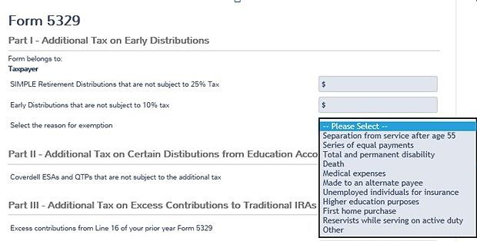
Early Distribution – Code 1
IRA distribution prior to age 59½ subject to 10% additional tax
Some early distributions may be exempt from additional tax – open Form 5329

Slide 40
Common Form 5329 Exception Codes
Avoid additional tax if distribution was:
  03 due to total and permanent disability
  04 due to death
  05 for medical expenses >10% of AGI*
  07 made for unemployed individual health insurance premiums*
  08 made for higher education expenses*
See Pub 4012, page H-2 for complete list of exception codes
* Distributions do not have to be specifically for stated expenses, but distribution and expenses must occur in same tax year
Notes:
* For codes 5, 7 & 8, the distributions do not have to be specifically for the stated expenses, but the distribution and the expenses must occur in the same tax year.

Slide 41
Traditional IRA Distributions
Traditional to Roth Conversion – Code 2
  Fully taxable if no basis in Traditional IRA
  No penalty
  Out of scope (requires Form 8606 Part II)
Notes:
Emphasize need to look at Box 7 at interview stage to determine if in scope!
Caution: Code 2 can be used for other distributions, e.g. distribution to a Public Safety Officer after age 59 1/2

Slide 42
Qualified Charitable Distribution
Qualified Charitable Distribution (QCD) must be direct from IRA trustee to charity
QCD counts towards the taxpayer’s required minimum distribution (RMD)
QCD is generally a nontaxable distribution
Notes:
Qualified Charitable Distribution made permanent.
New Notes in Pub 4491 for 2016 TY:
A qualified charitable distribution (QCD) is generally a nontaxable distribution made directly by the trustee of the IRA to an organization eligible to receive tax-deductible contributions.
The taxpayer must be at least age 70 ½ when the distribution is made.
The taxpayer must have the same type of acknowledgements of the contribution that is needed to claim a deduction for a charitable contribution.
A QCD counts towards the taxpayer’s required minimum distribution (RMD).
The maximum annual exclusion for QCDs is $100,000.
Any QCD in excess of the $100,000 exclusion limit is included in income as any other distribution.
On a joint return, the spouse can also have a QCD and exclude up to $100,000.

Slide 43
Qualified Charitable Distribution
Taxpayer must be at least age 70½ when distribution is made
Taxpayer must have same type of acknowledgement of contribution that is needed to claim deduction for a charitable contribution

Slide 44
Qualified Charitable Distribution
Maximum annual exclusion for QCDs is $100,000
  Any QCD in excess of $100,000 exclusion limit is included in income as any other distribution
  On joint return, spouse can also have a QCD and exclude up to $100,000

Slide 45
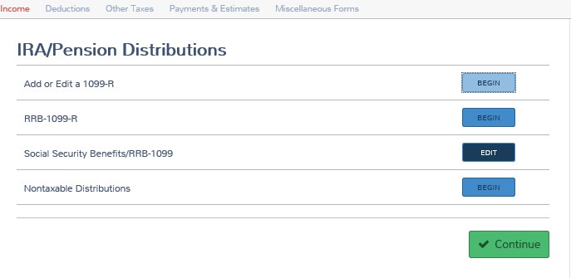
Form 1099-R for QCD
Shows the three nondeductible distributions, tells Counselor NOT to include the distribution in Line 2 of 1099-R and to subtract distribution from gross amount on Line 2.

Slide 46
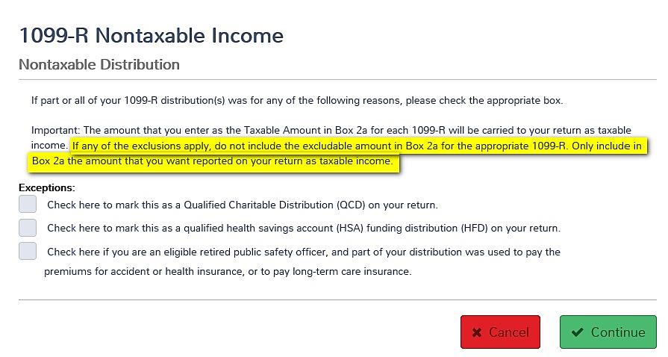
Nondeductible Distributions

Slide 47
“Pension” Distributions
Reported on Forms
  1099-R – company plans
  RRB-1099-R – (green) Railroad Benefit
  CSA-1099-R – civil service, government
Notes:
The term “Pensions” is used generically to refer to employer-sponsored retirement plans
Pension income is generally reported on form 1099-R but may also be reported on RRB-1099-R (green portion) for railroad retiree or Form CSA-1099-R for civil service employees.
Premature IRA distributions prior to age 59½ may result in a 10% tax additional tax. There are exception codes.

Slide 48
Definitions
Pub 17, Ch 10
Pension: Series of determinable payments made to employee (or survivor) after retirement from work
Annuity: Payments under contract from insurance company, trust company or individual
Notes:
48

Slide 49
Interview
With 1099-R in hand – IRA box not checked:
  Did taxpayer make non-deductible contributions?
  If disability pension income, is taxpayer under retirement age?
  Is taxpayer a retired public safety officer?

Slide 50
1099-R
What is this form telling you?
1616
Notes:
Click 1 – Gross distribution
Click 2 – Taxable amount – NOTE: If taxable amount is determined no further action is needed to determine taxable amount
If Taxable amount not determined is checked, Simplified General Rule calculation may be required. Box 9b indicates employee contribution which will be used in the Simplified General Rule if taxable amount is not included in box 2a
If box 2a is zero (not just blank), and box 2b is not checked (the taxable amount was determined) the distribution is non taxable (use exclusion worksheet line 5 to exclude the amount)
Click 3 – Distribution code covered in one of next charts
Click 4 – Federal and State Income tax withheld

Slide 51
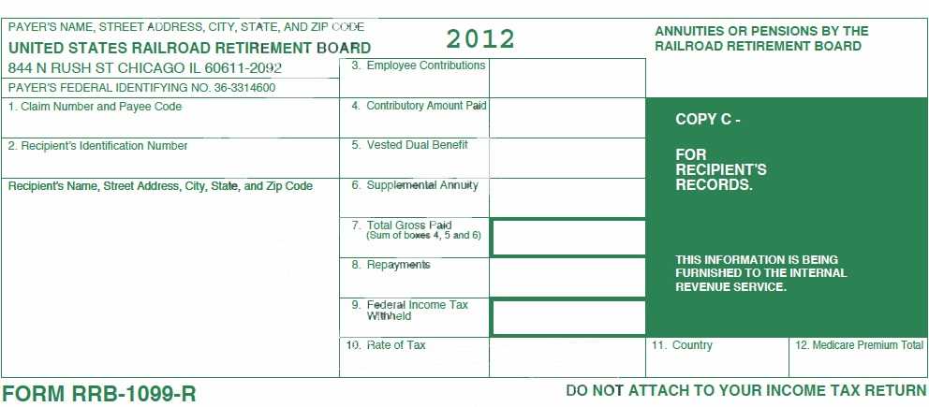
Railroad Retirement RRB -1099-R – Tier 2 Benefits Green
2016
1,089.16
-0-
-0-
354.00
Notes:
Click 1 – Total Gross Paid
Click 2 – Federal Income Tax withheld
Click 3 – Employee Contribution. Use Bogart calculator to determine taxable portion of Tier 2 benefits.
Click 4 – Medicare Premium that needs to be added to Schedule A
See Pub 4012 for directions for entering information. Distribution code is generally 7

Slide 52
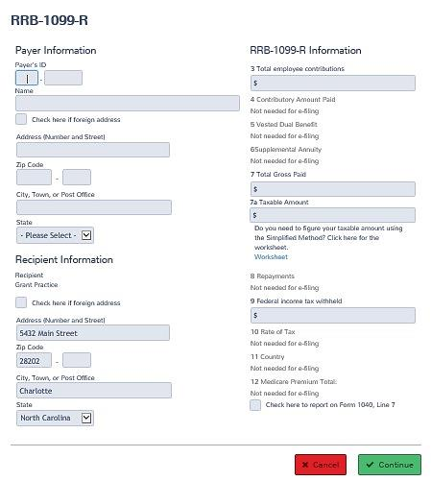
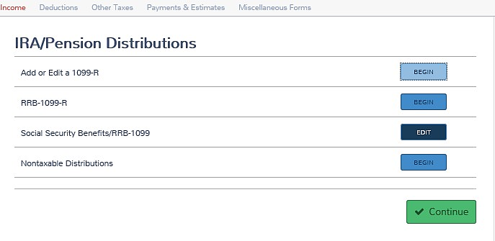
RRB-1099-R – Tier 2 (2nd , 3rd, & 4th green forms) Annuities or pensions
Click begin
Enter all data as it appears on the form.
It is not necessary to move data to
other boxes.
Notes:
RRB Social Security Equivalent (RRB-1099) Tier 1 is covered in lesson # 22 Income Social Security.
Use Bogart calculator to determine taxable portion of Tier 2 benefits when RRB-1099-R contains employee contributions in box 3.
For state returns will need to subtract the taxable portion of Tier 2 as the information does not flow to the state return and all states do not tax Railroad Retirement benefits.

Slide 53
Disability Retirements Code 3
Until taxpayer reaches employer’s minimum retirement age
  Disability payments taxed as wages
  Reported on 1040 line7, eligible for Earned Income Credit
Once retirement age is reached
  Disability payment taxed as pension*
  Reported on 1040 line 16
Notes:
Ask the taxpayer when minimum retirement age is for the plan.
State with Homestead may continue to tax the pension as disability. Check with your state!
*Even when the taxpayer reaches 65, some states continue to report the pension as a disability.

Slide 54
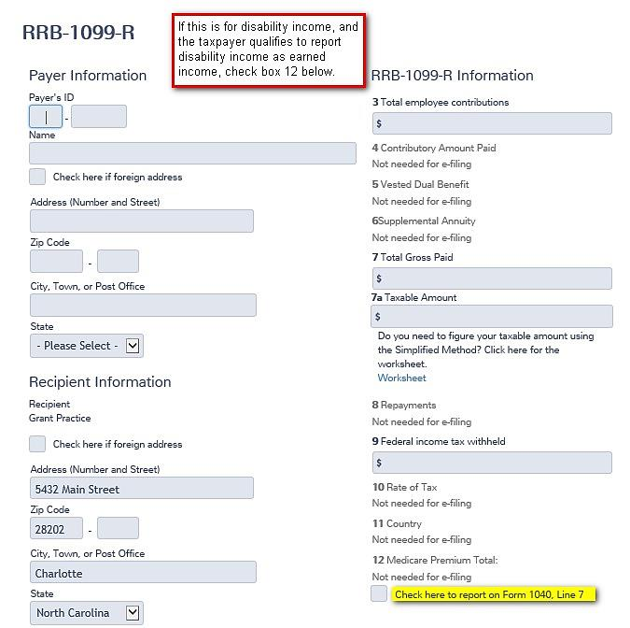
Entry of Disability in TaxSlayer

Slide 55
Civil Service Pensions
Same rules as private employer plans
Slightly different form
Box 5 has either health insurance charges or basis recovered this tax year
  Must ask the taxpayer what the amount is for
  Insurance charges are entered on the medical section of Schedule A
Notes:
Box 5 can also have the nontaxable portion of the distribution
Such as when the taxable amount is determined by the payer

Slide 56
Civil Service Pensions continued
Input exactly as on form
  Use simplified method if applicable
    Simplified Method and Simplified General Rule are the same and are In Scope
    General Rule is OUT OF SCOPE
  Use Public Safety Officer medical if applicable
    Use Bogart Pension Calculator
    http://tools.cotaxaide.org/Annuity%20Calculator.html
    Check box to indicate for Public Safety Officer
Notes:
Note if qualified payment is greater than $3000 the balance can be entered on Sch A detail.
Survivor benefits attributable to a Public Safety Officer who was killed in the line of duty before 1/1/97 are excludible for Federal
To reach the input screen for Public Safety Officer, first select Nontaxable Distribution from the IRA/Pension Distribution Screen, which will take you to the 1099-R Nontaxable Income screen where you will check the box to indicate for PSO.

Slide 57
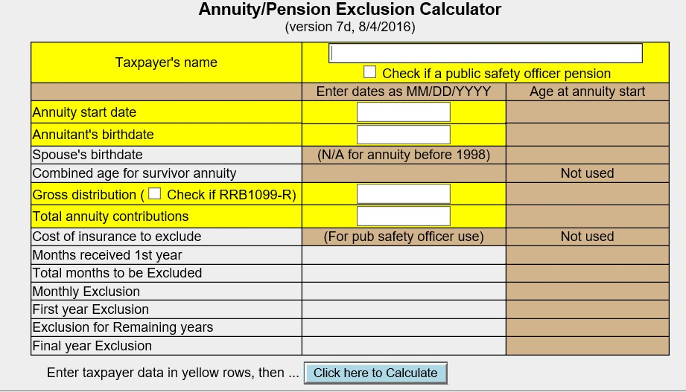
Bogart Pension Calculator with PSO
http://tools.cotaxaide.org/Annuity%20Calculator.html

Slide 58
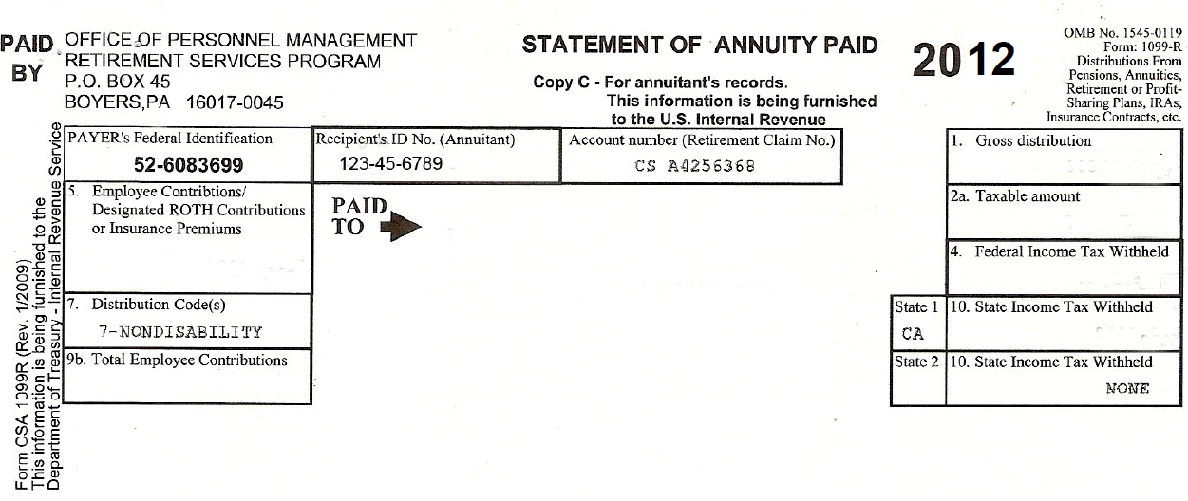
CSA 1099-R
20XX
2016
Health Insurance premium or basis recovered in tax year or both
If health Insurance premium, enter on Schedule A
Notes:
Box 1 – Gross distribution
Box 2 – Taxable amount
Box 7 – Distribution code
Boxes 4 and 10– Federal and State Income Tax withheld
Box 9b – Total employee contribution to be used in Simplified General Rule
Box 5 – Amount entered here is generally health insurance premium but may represent or include the difference between total distribution and the taxable distribution (basis recovery).ASK THE TAXPAYER!
If distribution in box 9b is pre 7/2/1986 the three year rule applies and amount cannot be used.

Slide 59
Taxable Distributions
Payer reports taxable portion of distribution in Box 2a on Form 1099-R
Retirement plans are funded by either before-tax or after-tax contributions
  Before-tax – entire distribution will be fully taxable
  After-tax – distributions partially taxable (box 9b Form 1099-R)
    “Taxable amount not determined” checked
Notes:
If taxpayer says that they have been using the General Rule, send them to a paid preparer.
Simplified General Rule is IN SCOPE while General Rule is OUT OF SCOPE

Slide 60
Taxable Distributions
Two methods used to figure taxable portion
  General Rule – Out of Scope
  Simplified Method/Simplified General Rule – In scope
Notes:
If taxpayer says that they have been using the General Rule, send them to a paid preparer.

Slide 61
Simplified Method Information Needed
To calculate you will need:
  Gross distribution amount (from 1099-R Box 1)
  Cost in plan (Box 9b Form 1099-R or Box 3 RRB-1099R)
  Annuity Start Date – Relies on good interview if the spouse receives the annuity and does not remember the start date
  Age – Taxpayer’s age on date annuity began
    Spouse’s age if joint/survivor annuity is selected
    Note if annuity starting date is before or after taxpayer’s birthday for that year
  Amounts previously recovered
  Number of months paid in 2016 TY
Notes:
If the starting date of the payments was prior to July 2, 1986, the taxpayer used either the General Rule (which is out of scope) or the “Three Year Rule”. If the latter, the entire amount of the taxpayer’s contribution would have been recovered by now and the entire amount of the payment received this year should be entered in box 2 on the Form 1099-R as taxable. (The “Three Year Rule” was repealed for annuities starting after July 1, 1986.)
If the starting date of the payments was after July 2, 1986, but before January 1, 1987, the annual exclusion continues even after all contributions have been exhausted – for the taxpayer and (if a joint annuity) the spouse, for the rest of their lives.
If the starting date of the payments was after 1986 and before November 19, 1996, the taxpayer had a choice of using the General Rule or the Simplified Method (with some restrictions) and then sticking with that choice. Alternately, the Simplified Method is referred to as the Simplified General Rule. Both are In Scope.

Slide 62
Two Ways To Calculate Taxable Amount
Use Bogart’s Pension Calculator only
  http://tools.cotaxaide.org
  Enter the taxable amount from completed Bogart on to 1099-R taxable amount box 2b
  Do not enter anything in TaxSlayer Worksheet
Use TaxSlayer Simplified General Rule Worksheet (TS SGRW)
  Let Bogart do the calculations
  Enter Bogart data into the TaxSlayer Worksheet
  Advantage: TS SGRW preserves the data used to calculate the return

Slide 63
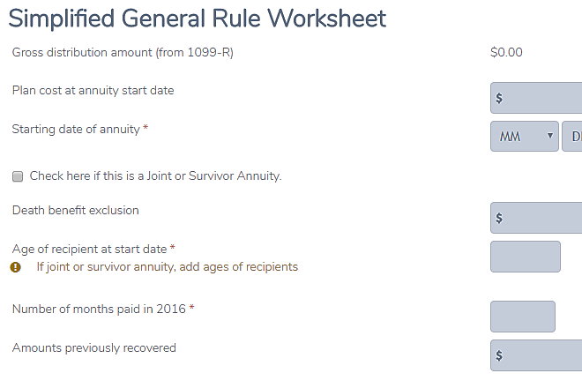
TaxSlayer:
Simplified General Rule Worksheet
AARP recommends using the
Bogart pension calculator instead
of this TaxSlayer worksheet.
http://tools.cotaxaide.org/Annuity%20Calculator.html

Slide 64
Pension Complications
Lump-sum (total) distributions
  Shown to right of Box 2 of Form 1099-R
  If Box 7 code is A – Special tax treatment options in Pub 17 – Out of Scope
Premature distributions – Same rules and penalties as IRAs

Slide 65
Pension Distribution – Special Case
Taxpayer dies while still employed
Spouse survives – Draws survivor benefits from pension of deceased Taxpayer
Must use only date of birth of spouse and date when spouse started receiving benefit for simplified method
Notes:
65

Slide 66
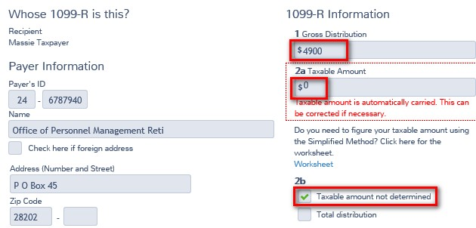
Special Case 2
Box 1 has a gross distribution amount
Box 2a has “0”
Box 2b not checked
Taxable amount was
determined due to
Box 2a 0 on tax document!
Notes:
66

Slide 67
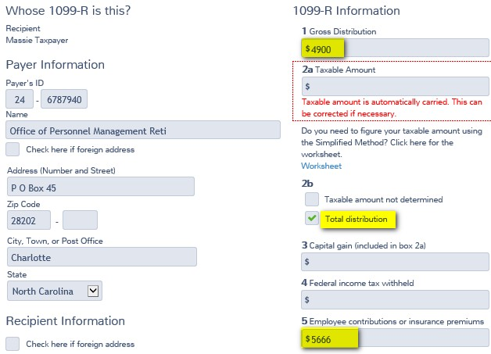
Special Case 3
Box 1 has gross distribution amount
Total distribution box is checked
Box 5 has number equal to or larger than Box 1
Notes:
67

Slide 68
Special Case 3
Confirm underlying facts with taxpayer
  Cashed out an annuity?
  Other termination of plan?
Notes:
68

Slide 69
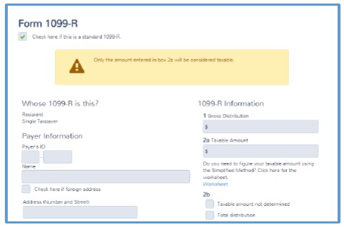
Special Case 3
TaxSlayer defaults the whole distribution as taxable
Delete data in Box 2a and leave blank
If Box 2 is locked in, start over
Enter data in Box 1, delete data in Box 2a, and enter zero (0)
What if the distribution is not taxable?
Notes:
69

Slide 70
Special Case 3 –
Zero out taxable amount
May have a loss on annuity if “total distribution” (box checked) and box 5 is greater than box 1
Potential itemized deduction for unrecovered investment in the contract
  Not subject to 2% of AGI floor if due to death of annuitant
  Otherwise, subject to 2% of AGI floor
Notes:
70

Slide 71
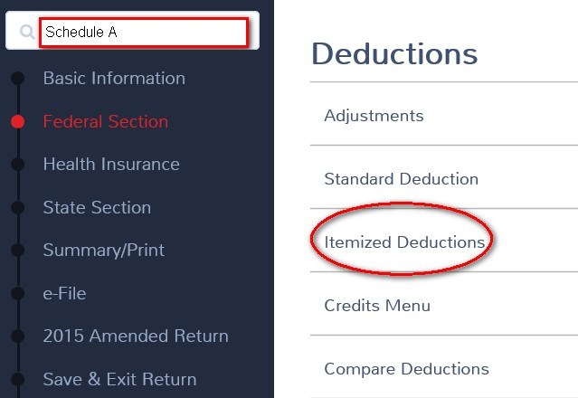
Special Case 3 – Open Schedule A
Type Schedule A in Enter the Form Number OR through Deductions

Slide 72
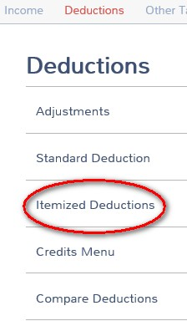
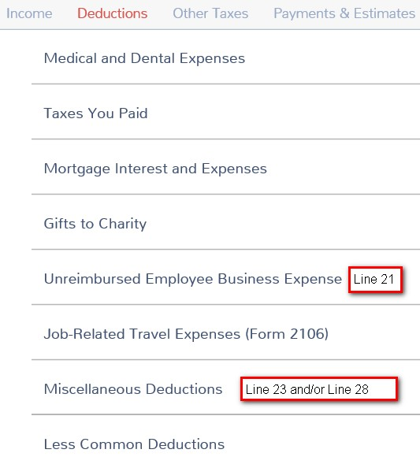
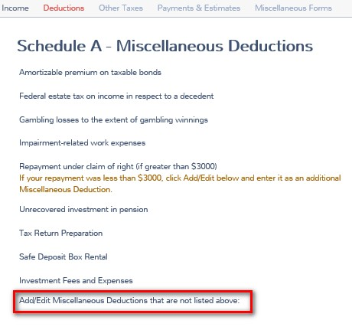
Special Case 3 – Link to lines 23 or 28
Step 1
Step 2
Step 3

Slide 73
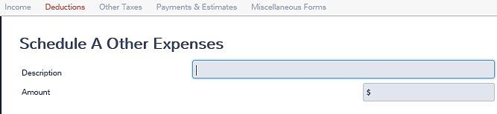
Special Case 3
Describe and enter the loss amount
Employee contribution box 5: $6,500
Less total distribution box 1: -5,000
Loss amount to enter $1,500
2016

Slide 74
Distributions
Taxability computed separately on each
1099-R
Input one at a time and complete all input related each form
Notes:
74

Slide 75
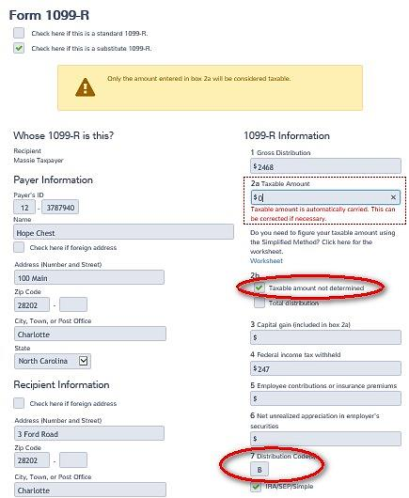
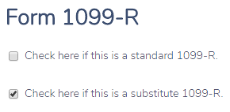
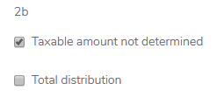
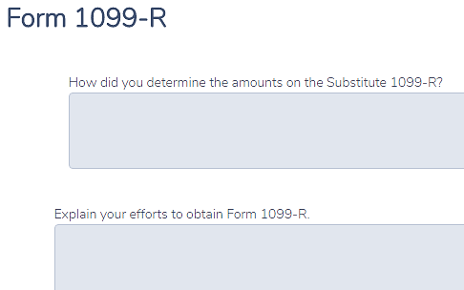

Missing 1099-R –
TaxSlayer Creates Form 4852
Check second box if attempts to get a corrected 1099-R have failed.
Answer the highlighted questions below which pop up
How did you determine the amounts on the Substitute 1099-R?
Explain your efforts to obtain Form 1099-R
Notes:
Do not use 4852 if taxpayer was not treated as an employee

Slide 76
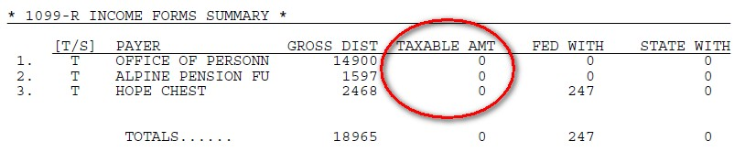
Form 4852 -
If the taxable amount is calculated and turns out to be zero,
enter zero on the 1099-R.
Zero entered on the 1099-R does not show up on the 4852 shown on the next slide.

Slide 77
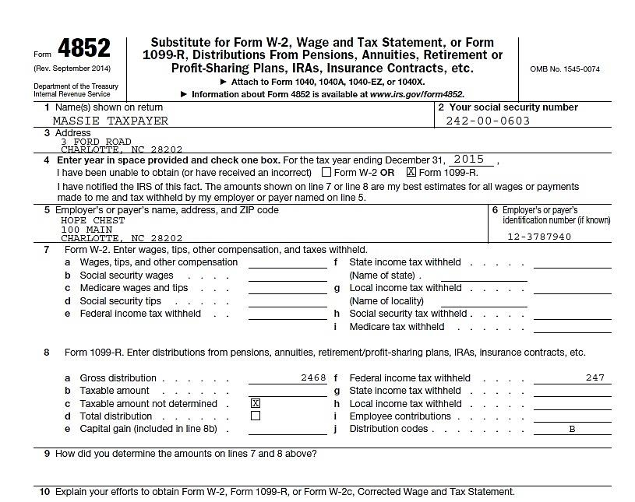
Form 4852 – Completes itself

Slide 78
Missing 1099-R – Form 4852
Taxpayer should retain copy of 4852
If taxpayer later receives 1099-R with different information, may need to amend return
Notes:
From Instructions to Form 4852:
Retain a copy of Form 4852 for your records
Check your Social Security Statement (received at least a full year after the date shown on line 4) against Form 4852
If the earnings you reported on Form 4852 are not shown in the statement, you should contact the Social Security Administration (SSA) at the telephone number shown on the statement
Alternatively, after September 30 following the date shown on line 4, you may contact your local SSA office to verify wages reported by your employers

Slide 79
1099-R Recipient ID Number
Taxpayer has ITIN, not SSN
  1099-R has wrong ID number
  Cannot be e-filed
  May be paper filed
If no recipient ID number
  Not a valid 1099-R
  Return is out of scope

Slide 80
Quality Review
Check accuracy of 1099-R input
  EIN!
  Withholding!
  Carry forward data updated?
Is there an exception for early distribution

Slide 81
Quality Review (cont)
Was it a self-rollover? Did taxpayer meet rules?
Look at 1040 lines 15 and 16 to confirm amounts are correct and that documents are reflected on the correct lines
Make sure Fed and State Income Tax withheld is entered

Slide 82
Exit Interview
May need to explain 10% additional tax on early withdrawal
Is taxpayer approaching 59½? 70½?
Adjust withholding for next year
  W-4P
  W-4V for government payments

Slide 83
IRA and Pension Income
Questions…
Comments…

